Slide 1


Green House Gas Emission
Predictive Modeling Of Supply Chain Emission Factors Using Data Quality Metrics (2010-2016)
Name: Farhat Nausheen Student ID:INTERNSHIP_1748923002683e727a876ea
AICTE Internship Student Registration ID : STU666ab794ad6281718269844

Slide 2

Learning Objectives
Build a robust machine learning model to predict Supply Chain Emission Factors with Margins.
Utilize historical data from 2010 to 2016, segmented by industry and commodity.
Incorporate both descriptive attributes (e.g., substance, unit) and data quality metrics (e.g., reliability, temporal, geographical, and technological correlation, data collection method).
Apply regression-based modeling, primarily using Random Forest.
Support sustainable decision-making in supply chain management through data-driven insights.
GOAL
Goal: Enable accurate and interpretable prediction of emission factors to drive environmentally responsible supply chain strategies.
Source :
www.freepik.com/

Slide 3
Tools and Technology used
Pandas – Data loading, cleaning, merging Excel sheets
NumPy – RMSE calculation and numerical ops
Matplotlib & Seaborn – Visualizations (heatmap, prediction plots)
Scikit-learn:
LabelEncoder, StandardScaler – Feature preprocessing
train_test_split – Data splitting
RandomForest, LinearRegression, GradientBoosting – Models
GridSearchCV – Hyperparameter tuning
mean_squared_error, r2_score – Evaluation metrics
joblib – Saved final model and scaler

Slide 4
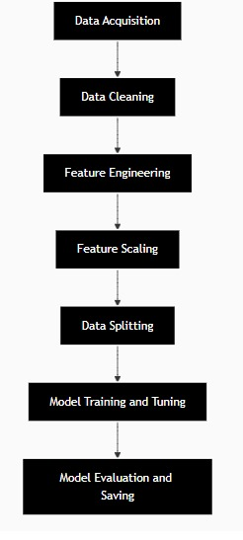
Methodology
Data Acquisition: Loaded Excel data (2010–2016) using pandas
Data Cleaning: Dropped unused columns & missing rows
Feature Engineering: Encoded Substance, Unit, Commodity Name
Feature Scaling: Standardized features using StandardScaler
Data Splitting: Train-test split using train_test_split
Model Training: Built 3 models — RF, Linear, Gradient Boost
Tuning: Optimized Random Forest using GridSearchCV
Evaluation & Saving: Measured RMSE, R²; saved model via joblib

Slide 5
Problem Statement:
Supply Chain Emissions Modelling Using Industry and Commodity Data (2010–2016)
You have annual supply chain emission data from 2010–2016 categorized into industries and commodities. The goal is to develop a regression model that can predict the Supply Chain Emission Factors with Margins based on descriptive and quality metrics (substance, unit, reliability, temporal/geographical/technological/data collection correlations, etc.).

Slide 6
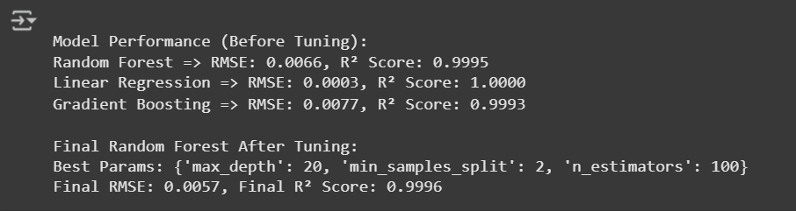
Solution:
Merged Excel datasets (2010–2016)
Cleaned data, handled nulls, selected key features
Encoded categorical columns with LabelEncoder
Normalized features using StandardScaler
Split data into training and testing sets
Trained 3 models: Random Forest, Linear Regression, Gradient Boosting
Tuned Random Forest using GridSearchCV
Evaluated using RMSE and R² Score
Saved best model and scaler with joblib
https://github.com/SalhaAfreen/EdunetFoundation-Shell-Greenhousegaspredictionproject

Slide 7
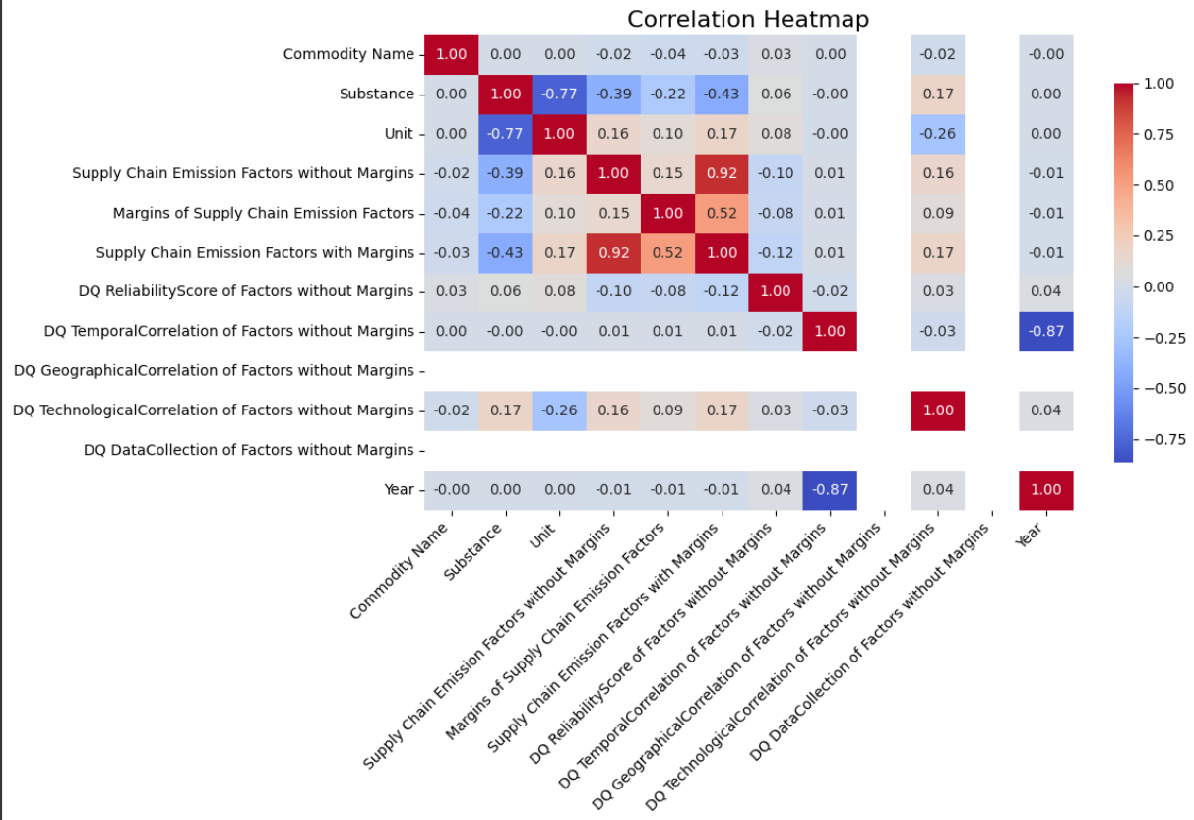
Screenshot of Output:

Slide 8
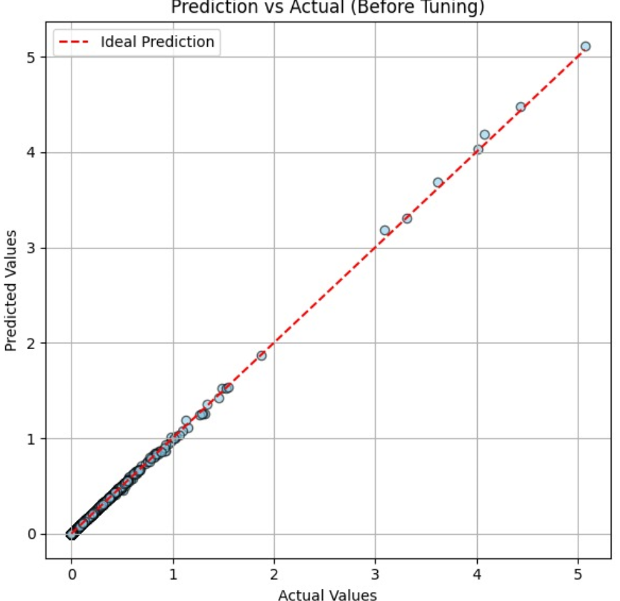
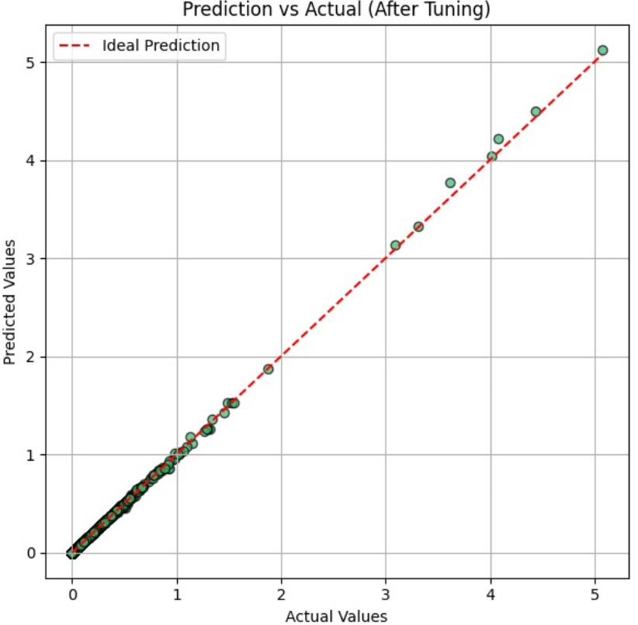
Screenshot of Output: Before and After Hyperparameter Tuning

Slide 9
Conclusion:
Successfully developed a regression-based machine learning model to predict Supply Chain Emission Factors.
Compared three models and achieved the best performance with the tuned Random Forest Regressor.
Feature importance analysis revealed key variables influencing emissions.
Emphasized the impact of scaling and categorical encoding on model performance.
The final model showed high R² and low RMSE, confirming its effectiveness.
Demonstrated how integrating domain knowledge with machine learning can lead to sustainable supply chain decisions.

